Slide 1


Social Media and Libraries
examples and ideas from American libraries
Elizabeth Stromme
Information Resource Officer

Slide 2
Agenda
What is social media?
Why use social media?
What types of social media are libraries using?
How are they using social media?
Tips if you are starting to use social media

Slide 3
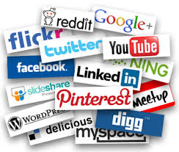
What is social media?
“Forms of electronic communication through which users create online communities to share information, ideas, personal messages, and other content.”
Merriam-Webster Dictionary

Slide 4
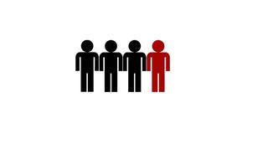
Why use social media?
Nearly 1 in 4 people worldwide use some sort of social media
Almost 2 billion people by 2014
http://www.newmediatrendwatch.com/world-overview/137-social-networking-and-ugc

Slide 5



What types of social media are libraries using?
A survey of American public libraries showed:
99% using
56% using
30% using
http://lj.libraryjournal.com/2013/05/marketing/social-media-libraries-are-posting-but-is-anyone-listening/

Slide 6
How are libraries using social media?
promoting events
sharing resources
starting conversations with users
having fun!

Slide 7
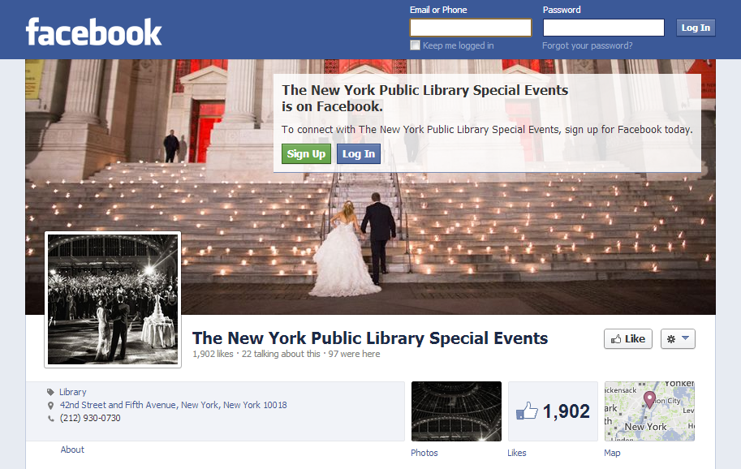
Promoting Events

Slide 8
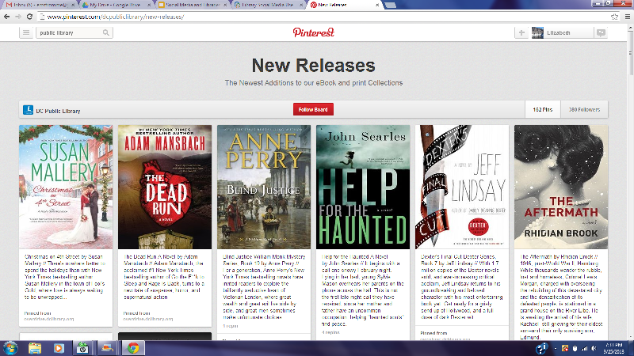
Sharing Resources

Slide 9
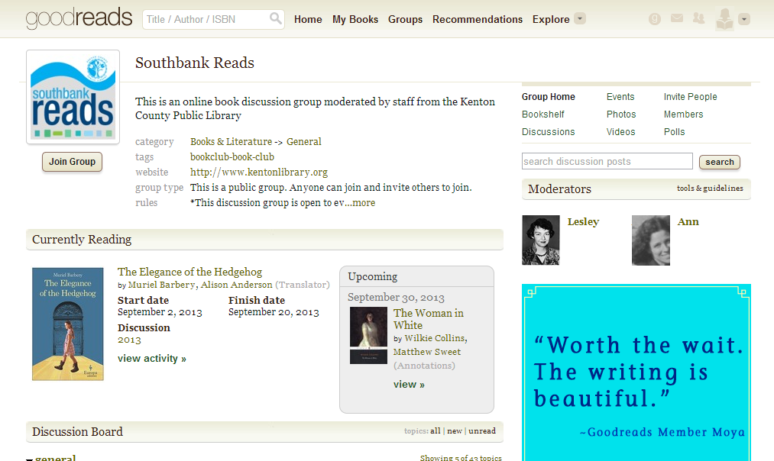
Starting Conversations with Users

Slide 10
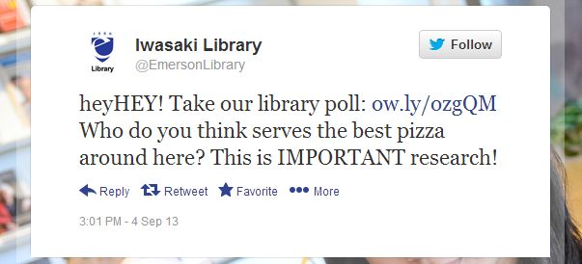
Having fun!

Slide 11
Tips
start small
choose one social media platform to begin
be regular
post on a schedule to keep your feeds fresh
use pictures
of events, of books, of users (with permission)
share about your community, not just your library
make your pages a destination!

